Slide 1
AI/ML Basics
Part 2
Clustering

Slide 2
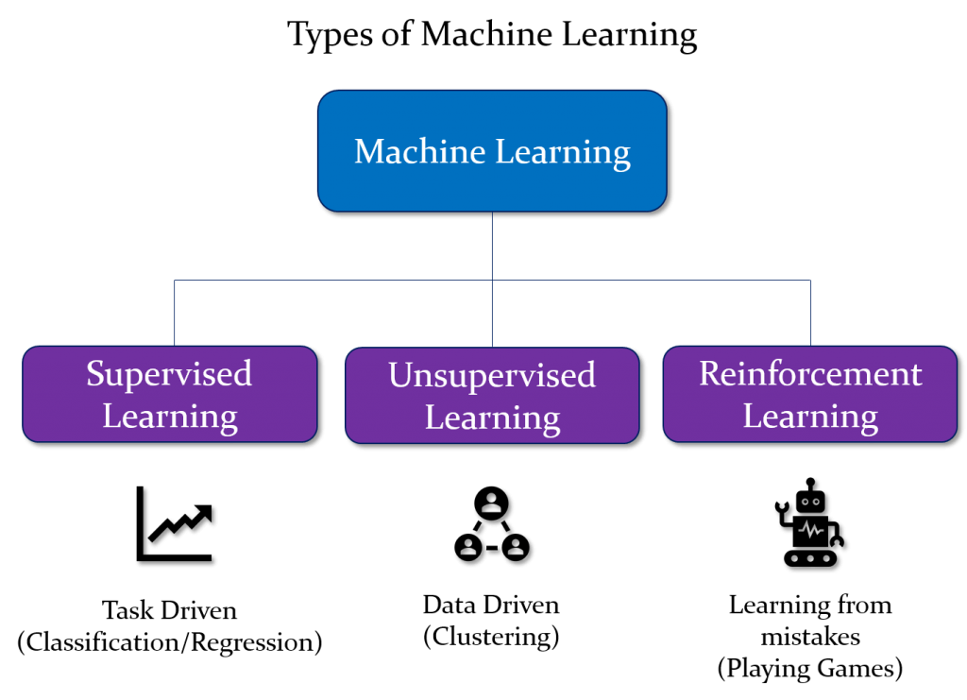

Slide 3
What is Unsupervised Learning ?
As the name suggests, unsupervised learning is a machine learning technique in which models are not supervised using training dataset. Instead, models itself find the hidden patterns and insights from the given data. It can be compared to learning which takes place in the human brain while learning new things. It can be defined as:
Unsupervised learning is a type of machine learning in which models are trained using unlabeled dataset and are allowed to act on that data without any supervision.

Slide 4
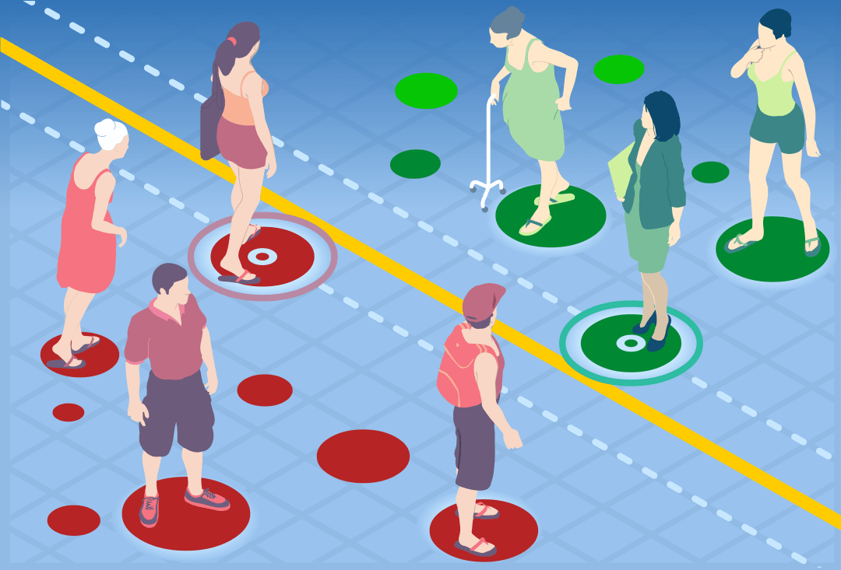

Slide 5
Clustering
Clustering is the task of dividing the population or data points into a number of groups such that data points in the same groups are more similar to other data points in the same group than those in other groups. In simple words, the aim is to segregate groups with similar traits and assign them into clusters.

Slide 6
Applications of Clustering
Clustering has a large no. of applications spread across various domains. Some of the most popular applications of clustering are:
Recommendation engines
Market segmentation
Social network analysis
Customer Segmentation
Medical imaging
Image segmentation
Anomaly detection

Slide 7
K-Means Algorithm
The K-means clustering algorithm computes centroids and repeats until the optimal centroid is found. It is presumptively known how many clusters there are. It is also known as the flat clustering algorithm. The number of clusters found from data by the method is denoted by the letter ‘K’ in K-means.
In this method, data points are assigned to clusters in such a way that the sum of the squared distances between the data points and the centroid is as small as possible. It is essential to note that reduced diversity within clusters leads to more identical data points within the same cluster.

Slide 8
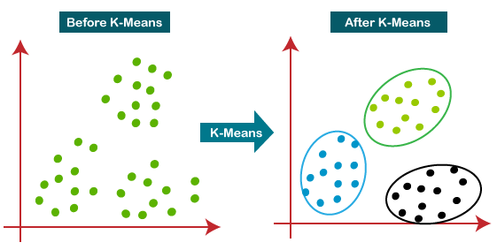

Slide 9
STEP 1: Let us pick k clusters, i.e., K=2, to separate the dataset and assign it to its appropriate clusters. We will select two random places to function as the cluster’s centroid.
STEP 2: Now, each data point will be assigned to a scatter plot depending on its distance from the nearest K-point or centroid. This will be accomplished by establishing a median between both centroids. Consider the following illustration:
STEP 3: The points on the line’s left side are close to the blue centroid, while the points on the line’s right side are close to the yellow centroid. The left Form cluster has a blue centroid, whereas the right Form cluster has a yellow centroid.
STEP 4: Repeat the procedure, this time selecting a different centroid. To choose the new centroids, we will determine their new center of gravity, which is represented below:

Slide 10
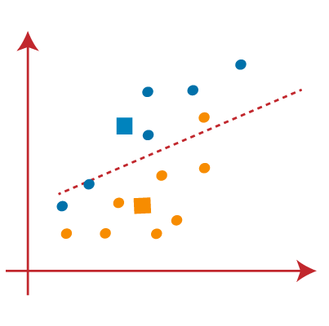
STEP 5: After that, we’ll re-assign each data point to its new centroid. We shall repeat the procedure outlined before (using a median line). The blue cluster will contain the yellow data point on the blue side of the median line.

Slide 11
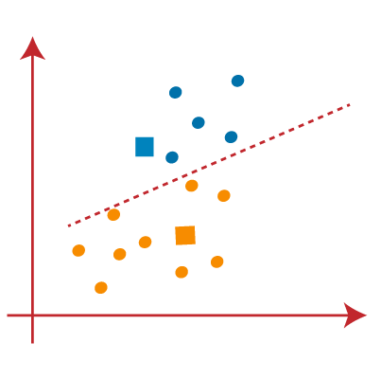
STEP 6: Now that reassignment has occurred, we will repeat the previous step of locating new centroids.

Slide 12
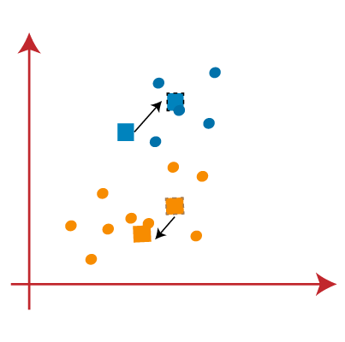
STEP 7: We will repeat the procedure outlined above for determining the center of gravity of centroids, as shown below.

Slide 13
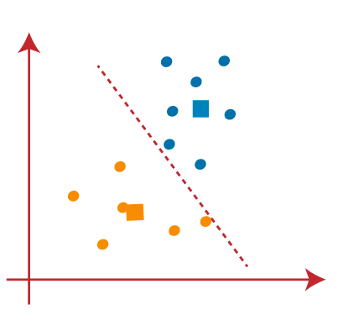
STEP 8: Similar to the previous stages, we will draw the median line and re assign the data points after locating the new centroids.

Slide 14
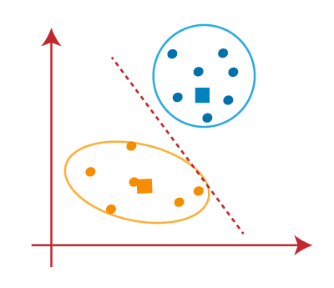
STEP 9: We will finally group points depending on their distance from the median line, ensuring that two distinct groups are established and that no dissimilar points are included in a single group.

Slide 15

The final Cluster is as follows:

Slide 16
Repo Link :
https://github.com/srihari-nagaraj/ai_ml_part_2

Slide 17
Any Questions ?

Slide 18
Thank You

